Slide 1
Cloud Computing Fundamentals

Slide 2
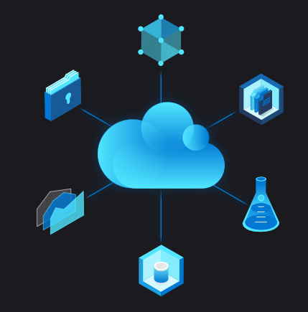
What is Cloud Computing
cloud computing is the delivery of computing services—including servers, storage, databases, networking, software, analytics, and intelligence—over the Internet (“the cloud”) to offer faster innovation, flexible resources, and economies of scale. You typically pay only for cloud services you use, helping lower your operating costs, run your infrastructure more efficiently and scale as your business needs change.

Slide 3
Benefits of Cloud Computing
Cloud computing is a big shift from the traditional way businesses think about IT resources. Here are seven common reasons organisations are turning to cloud computing services:
Cost - Cloud computing eliminates the capital expense of buying hardware and software and setting up and running on-site datacentres—the racks of servers, the round-the-clock electricity for power and cooling, the IT experts for managing the infrastructure. It adds up fast.
2. Global Scale - The benefits of cloud computing services include the ability to scale elastically. In cloud speak, that means delivering the right amount of IT resources—for example, more or less computing power, storage, bandwidth—right when it is needed and from the right geographic location.
3. Performance - The biggest cloud computing services run on a worldwide network of secure datacentre's, which are regularly upgraded to the latest generation of fast and efficient computing hardware. This offers several benefits over a single corporate datacentre, including reduced network latency for applications and greater economies of scale.

Slide 4
Benefits of Cloud Computing
Security- Many cloud providers offer a broad set of policies, technologies and controls that strengthen your security posture overall, helping protect your data, apps and infrastructure from potential threats.
Speed - Most cloud computing services are provided self service and on demand, so even vast amounts of computing resources can be provisioned in minutes, typically with just a few mouse clicks, giving businesses a lot of flexibility and taking the pressure off capacity planning.
Productivity - On-site datacentre's typically require a lot of “racking and stacking”—hardware setup, software patching, and other time-consuming IT management chores. Cloud computing removes the need for many of these tasks, so IT teams can spend time on achieving more important business goals.
Reliability - Cloud computing makes data backup, disaster recovery and business continuity easier and less expensive because data can be mirrored at multiple redundant sites on the cloud provider’s network.

Slide 5
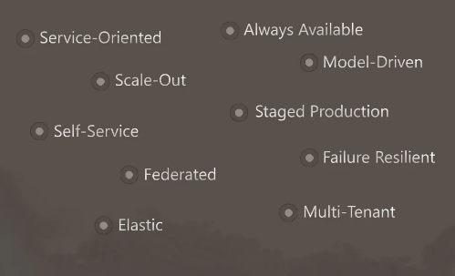
Generalized Cloud App Model

Slide 6
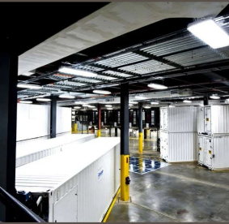
Microsoft Azure Data Center

Slide 7
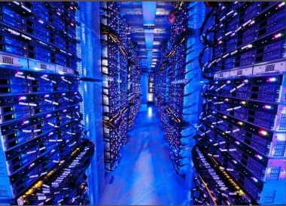
Microsoft Azure Data Center

Slide 8
Types of Cloud Computing
Public Cloud - Public clouds are owned and operated by a third-party cloud service providers, which deliver their computing resources like servers and storage over the Internet. Microsoft Azure is an example of a public cloud. With a public cloud, all hardware, software and other supporting infrastructure is owned and managed by the cloud provider. You access these services and manage your account using a web browser.
Private Cloud - A private cloud refers to cloud computing resources used exclusively by a single business or organisation. A private cloud can be physically located on the company’s on-site datacentre. Some companies also pay third-party service providers to host their private cloud. A private cloud is one in which the services and infrastructure are maintained on a private network
Hybrid Cloud - Hybrid clouds combine public and private clouds, bound together by technology that allows data and applications to be shared between them. By allowing data and applications to move between private and public clouds, a hybrid cloud gives your business greater flexibility, more deployment options and helps optimise your existing infrastructure, security and compliance

Slide 9
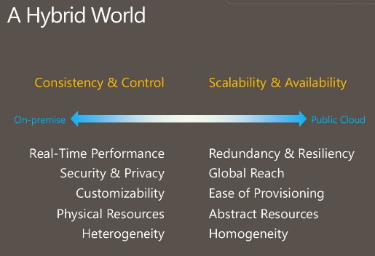
Hybrid Cloud

Slide 10
Types of Cloud Services
IaaS (Infrastructure as Service) - The most basic category of cloud computing services. With IaaS, you rent IT infrastructure—servers and virtual machines (VMs), storage, networks, operating systems—from a cloud provider on a pay-as-you-go basis.
PaaS (Platform as Service) - Platform as a service refers to cloud computing services that supply an on-demand environment for developing, testing, delivering and managing software applications. PaaS is designed to make it easier for developers to quickly create web or mobile apps, without worrying about setting up or managing the underlying infrastructure of servers, storage, network and databases needed for development.
Software as a service (SaaS)- Software as a service is a method for delivering software applications over the Internet, on demand and typically on a subscription basis. With SaaS, cloud providers host and manage the software application and underlying infrastructure and handle any maintenance, like software upgrades and security patching. Users connect to the application over the Internet, usually with a web browser on their phone, tablet or PC

Slide 11
Types of Cloud Computing
Serverless Computing: Overlapping with PaaS, serverless computing focuses on building app functionality without spending time continually managing the servers and infrastructure required to do so. The cloud provider handles the setup, capacity planning and server management for you. Serverless architectures are highly scalable and event-driven, only using resources when a specific function or trigger occurs.

Slide 12
Advantages of Cloud Computing
Lower Cost
Enhanced performance
Building of backup data, store data & recover data
Deliver Software on Demand
Analyse data
More scalability
More Throughput

Slide 13
Disadvantages
Vendor lock-in
Requires detailed cost estimation
Required planning of Cloud migration of Applications
Required new Skills

